Slide 1

Data Warehouse Architectures

Slide 2
Section: Introduction

Slide 3
Agenda
Understand the different types of data warehouse architectures.
Understand the difference between technical architecture and systems architecture.
Explain the components essential to all technical architectures.
Learn how the technical architecture components integrate
Discuss systems architecture common to data warehousing
Understand key terminology related to both technical architcture and systems architecture.

Slide 4

Data Warehouse Architecture
Technical Architecture (Data Flow Architecture)
System Architecture
How the data stores are arranged in the data warehouse and how data moves from data store to data store
Logical Architecture
Physical Configuration of Systems, Networks and Servers to support the Technical Architecture
Physical Infrastructure
ERP
ETL
DW
PeopleSoft ERP Oracle 12c
DW SQL Server 2012

Slide 5
Pre-Check: Architectures
It is important to understand the difference between systems and technical architectures. This exercise will test just that:
For each of the following select SA if its systems architecture and TA if its technical architecture.
A Multi-Dimensional database system, like Oracle Essbase
A Mainframe computer
Your Point-Of-Sale Application which is an OLTP source system
Cloudera Hadoop
Star Schemas

Slide 6
Section: The Components of Technical Architecture

Slide 7
Components at a Glance

Slide 8
Data Stores: Data At Rest
Typically stored in a DBMS, but does not have to be:
Multi-Dimensional Database Management Systems
Hadoop HDFS
On the File System
Mainframe / Legacy systems
Web Services (Twitter, Weather, Etc…)
Types:
User Facing – available to end-users for query purposes via applications
Internal – used by the data warehouse only not open to end-users
Hybrid – combination of internal and User-facing
External – not part of the data warehouse
External OLTP
Internal Stage
Hybrid ODS
Internal NDS
User-Facing DDS

Slide 9
ETL: Data In Motion
ETL = Extract, Transform, Load
It is a process for moving data from one store (source) to another (target).
It might be transformed along the way
Source DS
Transform:
Filter
Transform
Integrate
Classify
Aggregate
Summarize
Etc…
Target DS
Extract
Load

Slide 10
Data Architecture AT A Glance
OLTP
Source
ODS
ODS ETL
DDS
OLAP App.
OLTP
Source
Stage
Stage
ETL
OLTP
Source
NDS
NDS ETL
DDS ETL

Slide 11
Check Yourself: Types of Data Stores
An accounting system stored on your company's mainframe
A database of metadata use to manage data warehousing operations
A data mart
Operational data used by the data warehouse and by end users
Internal
External
Hybrid
User Facing
Notes:
User Facing – available to end-users for query purposes via applications
Internal – used by the data warehouse only not open to end-users
Hybrid – combination of internal and User-facing
External – not part of the data warehouse
ANSWERS
1 = B
2 = A
3 = D
4 = C

Slide 12
Section: Stage

Slide 13
Stage Data Store
Stage
An internal data store. It is not user-facing.
Stores extracts from source systems acting as a source for other systems in the data warehouse.
Reduces contention with source systems
Consolidates data from multiple sources
Change Detection
Snapshot data to a point in time.
OLTP
Source
OLTP
Source
Stage
ETL
Stage
OLTP
Source
Notes:
More on this in a bit but first.

Slide 14
4 Reasons To Stage Data
Resource Contention
Consolidation
Change Detection
Snapshotting

Slide 15
Resource contention
Staging data means we are not constantly Querying the OLTP source for data.
Stage queries the OLTP Source
Each of the subsequent processes queries stage
Order
Processing
ETL
Very Busy
E-Commerce Platform
ExtractOrders
ETL
Stage:
Orders
Supply-Chain
ETL
Sales Forecasting
ETL

Slide 16
Consolidation
Staging data provides us with a place where we can consolidate data from multiple sources
Marketing Customers
Extract
ETL
Stage: 3 Customer Data Sets
Stage:
1 Customer Data Set
Consolidate On Business Key
ETL
E-Commerce Customers
Extract
ETL
PoS Customers
Extract
ETL

Slide 17
Change Detection
Staging data gives us a reference point for detecting changes in new data.
We can compare new data to data already have in stage to determine which data has changed
Stage:
Customers +
Prev Customers
Customer Data
Changes in Customer
ETL
NDS:
Customer
Extract Customers
ETL

Slide 18
Snapshotting
We use snapshotting to build up time-variance in data that is point-in time.
Allows us to build a history of data at source with no time variance.
Stage:
Each Extract of Inventory
NDS:
History Of Inventory
Current Product Inventory Data
Changes in Inventory Over Time
ETL
Extract Current Inventory
ETL

Slide 19
Check Yourself: Staging
You need to add time variance to point in time data
Source systems are overburdened with data extracts
You need to determine which data in source is different from that in the warehouse
Data must be combined from multiple sources
Snapshotting
Resource Contention
Change Detection
Consolidation

Slide 20
Section: Data Stores in the DW

Slide 21
NDS: Normalized Data Store
NDS
An internal data store. Not user-facing.
Used as the Organization's source of a "single version of the truth" for other systems.
Subject-oriented, integrated, non-volatile and time-variant data from the OLTP sources.
Stored in 3rd Normal form, to reduce redundancy.
Use as a source for data marts and decision support systems, which use DDS.
Grows in size over time due to historical data.

Slide 22
Example Of NDS Data
Normalized to 3NF
PK different than source PK
Metadata columns to track changes to data
Cust Key | CID | Last | First | … | Created On | Last Update
10056 | 45 | Ismoore | Les | … | 2017-05-01 9:00
10057 | 56 | Mi | Mary | … | 2017-05-01 14:50 | 2017-05-02 16:20
PK
Business Key
Metadata

Slide 23
ODS: Operational Data Store
ODS
A hybrid data store. Parts are internal, parts are user-facing.
Integrated, detailed, volatile, and current data from source systems.
Key differences:
Volatile – data are updated and removed to reflect current.
Consolidated from disparate sources.
Does not grow over time. References a point in time, which is typically "now".
Structured differently than NDS or DDS and therefore should be stored as a separate DBMS.
Notes:
More on this in a bit but first.

Slide 24
Example of ODS DAta
Consolidated from multiple sources
Tells an important informational picture of "right now"
Not time-variant, but consolidated.
Order ID | Amount | Customer | Status | … | Last Update
10056 | $1500.00 | Les Ismoore | Packaging | … | 2017-05-02 15:30
10057 | $3500.00 | Mary Mi | Shipping | … | 2017-05-02 16:20
Metadata
Notes:
More on this in a bit but first.

Slide 25
DDS: Dimensional Data Store
DDS
A user-facing data store.
Subject-oriented, integrated, non-volatile, and time-variant data from source systems.
Stored in dimensional format to support ad-hoc analytical query by end users and decision support systems.
RDBMS → Star Schema
MDBMS → Cube
Grows in size over time due to historical data.
Data are consolidated and de-normalized. So no single version of the truth, but its easier for business users to query.
Notes:
More on this in a bit but first.

Slide 26
Example of DDS Data
Same data in there more than once, for historical purposes.
Only one row is current.
Product Key | Product Description | Product Code | Department | Effective Date | Expiration Date | Current Row
11981 | Stapler, Red | ST901 | Accessories | 4/7/2010 | 9/1/2011 | N
20342 | Stapler, Red | ST901 | Supplies | 9/2/2011 | 3/31/2013 | N
45393 | Stapler, Red | ST901 | Office Supplies | 4/1/2013 | 12/31/9999 | Y
PK
Business Key
Metadata

Slide 27
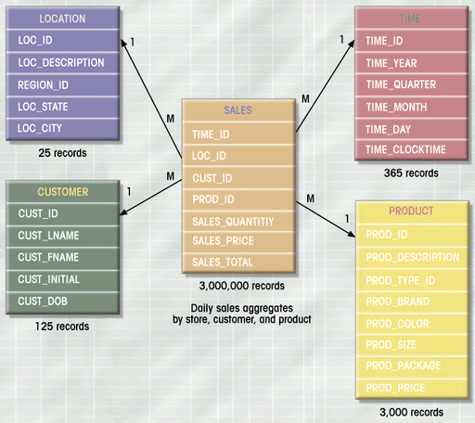
DDS: ROLAP / Star Schema / Data MArt
When the DDS is implemented in a Relational DBMS it is called ROLAP.
Relational Online analytical processing (ROLAP)
The schema is a star schema because of the consistent M-1 structure between Fact and Dimension tables
A Single Star Schema is known as a Data Mart.

Slide 28
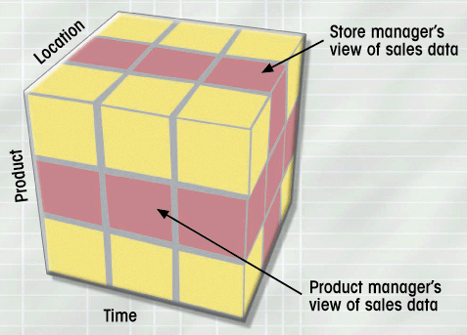
MDS: MOLAP / Cube
When the DDS is implemented in a Multi-Dimensional DBMS it is called MOLAP.
Multi-Dimensional online analytical processing (MOLAP)
Facts are pre-aggregated across all dimensions for improved performance.
Supports Semantic Metadata
Notes:
Semantic metadata means: soting attributes accurately like days of

Slide 29
Example Of Semantic Metadata
Relational (No Semantics) Sorts Alphabetically ☹
Multi-Dimensional (Semantics) Sorts By Day of the Week ☺
Day Of The Week
Friday
Monday
Saturday
Sunday
Tuesday
Thursday
Wednesday
Day Of The Week
Sunday
Monday
Tuesday
Wednesday
Thursday
Friday
Saturday

Slide 30
Check Yourself: Data Stores
Match the data store to its type
NDS
DDS
ODS
Type
Hybrid
Internal
User-Facing

Slide 31
Metadata
Metadata
Metadata means "Data about the data." It is an essential part of the data warehouse technical architecture.
Metadata is internal
3 Types:
Technical Metadata – Infrastructure oriented. Indexes, table partitions, data types, data transformations. Security.
Business Metadata – User oriented. Data structure definitions, Data dictionaries, implicit data hierarchies, data quality screens.
Process Metadata – System oriented. Performance metrics and measurements. Auditing the ETL Processes.

Slide 32
Section: Common TA's

Slide 33
Common Technical Architectures
COMPLEXITY
Independent Data Marts
Centralized
Enterprise Bus Architecture
With ODS (ODS + DDS)
Hub And Spoke
With ODS
Federated With ETL
Federate with EII

Slide 34
1. Independent Data Marts
Ad hoc “grassroots” technical architecture
Easy to get started with, difficult to scale.
Departmentalized, lacking enterprise focus.
No data consistency or data integration between data marts.
Data marts do not share dimensions
Data is sourced independently for each data mart.
OLTP Source Systems
Payroll DDS
Sales DDS
Inventory DDS
Forecasting DDS

Slide 35
2. Centralized
Next step up from Independent Data Marts.
Data marts are consolidated into a single DDS.
There is still lack of integration among the Dimensions, and there are copies of dimension for each data mart which requires them.
More enterprise focus, but still no data consistency among data marts.
OLTP Source Systems
Stage
DDS Product Dimension for Sales
Product Dimension for Inventory

Slide 36
3. Enterprise Bus
Next step up from centralized.
Like centralized, all data marts in the DDS
Conformed Dimensions, meaning they are re-used across the data marts. Just a single dimension for master data.
Difficult to achieve as enterprise focus is required when building data marts.
This is the Kimball Technical Architecture
OLTP Source Systems
Stage
DDS
Single Product Dimension Shared between Sales and Inventory

Slide 37
3.1 Enterprise Bus with ODS
Variation on Enterprise Bus includes an ODS for reporting on current, consolidated data.
ODS and Stage if need be are the source of the DDS.
Conformed dimensions like Enterprise Bus.
OLTP Source Systems
Stage
ODS
DDS
Single Product Dimension Shared between Sales and Inventory

Slide 38
4. Hub And Spoke
Next step up from Enterprise Bus
Data Sourced Systematically for "Single version of the Truth"
Dimensional Models in Data Marts are distributed and sourced from the NDS.
Added complexity of 3NF data but reduced complexity of conformed dimensions.
Inmon Technical Architecture
ODS can be added between stage and NDS just like with Enterprise bus.
OLTP Source Systems
DDS Sales Data Mart
Stage
NDS
DDS Forecast Data Mart
DDS Inventory Data Mart

Slide 39
4.1 Hub And Spoke with ODS
Full Inmon Corporate Information Factory
ODS is consolidated and current version of data.
ODS is sourced from stage or the NDS
ODS or Stage can populate the NDS
OLTP Source Systems
DDS Sales Data Mart
Stage
ODS
NDS
DDS Forecast Data Mart
DDS Inventory Data Mart

Slide 40
Check Yourself: Which TA?
Match the technical architecture to the example
Hub and Spoke
Independent Data Marts
Enterprise Bus
Centralized
Example
Data Marts distributed over the enterprise
Data Marts distributed over the enterprise with a single normalized data store
A single dimensional data store with conformed dimensions
A single dimensional data store without conformed dimensions.
Notes:
1 = B
2 = A
3 = C
4 =D

Slide 41
Federated With ETL
Applications
Most Complex Technical Architecture
Cases where you have several data warehouses, such as through mergers and acquisitions.
ETL Unifies disparate sources into a single Federated Data Warehouse
Used to integrate existing Data Marts, Warehouses and legacy applications into a single logical data warehouse.
FDW
ETL
DW1
DW3
DW2

Slide 42
Federated With EII
EII = Enterprise Application Integration
Federation is achieved through the EII application, or by building your own services.
Outputs are aggregated on the fly so there is no need to consolidate data into a single data warehouse.
Applications
EII
DW1
DW3
DW2

Slide 43
Check Yourself: Federated
If you had to federate a data warehouse, what do you think are the pros / cons of the ETL and EII approaches?

Slide 44
Section: Corporate Information Factory

Slide 45
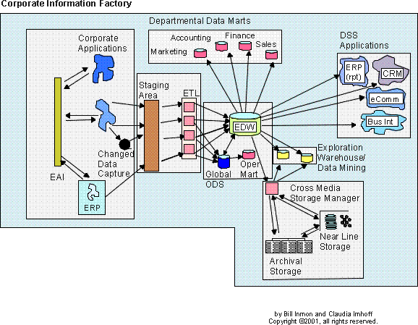
Inmon's Corporate Information Factory
The CIF is a
reference architecture
Notes:
As you may recall from our previous unit, data warehousing exists because the structure of our business data is not suitable for reporting – especially long-term trends. Therefore we need to “re-shape” our data to suit the reporting needs of the organization.
Inmon’s corporate information factory is a reference architecture for “data warehousing” it explains the systems and components required to “do” data warehousing.
One thing that might be confusing to you at this point is that the name of this course is “Data Warehousing” yet when you look at this diagram, the data warehouse is the tiny cylinder is the center of the picture.
I think of the term “data warehousing” as the overall activity… collecting, extracting, re-shaping data, then storing it for reporting and analytic purposes. One of the key cogs in this process is the “Enterprise Data warehouse” as described by Inmon. So to me “data warehousing” is represented by all the components you see in this picture, with the Enterprise Data warehouse being one of those components.

Slide 46
Understanding the Diagram
Cylinders
Data Stores
Rectangles: Components
Blobs: Applications
Boxes: Processes
The CIF is a
reference architecture
Notes:
Big white boxes – main components
Funny shapes represent applications
Cylinders are data stores – typically in a RDBMS ( Oracle, Sybase, SQL Server) or MOLAP ( Oracle Essbase, IBM Cognos, MS Analysis Services)
Boxes represent processes or programs.

Slide 47
Check Yourself: Which TA?
The Corporate Information Factory represents which Technical Architecture?

Slide 48
External World & Applications
The CIF is a
reference architecture
Notes:
First we’ll look at the external world and applications – highlighted in yellow

Slide 49
External World & Applications
External World – the people and systems that generate operational data. Transactional in nature. Called external world because they can come from anywhere.
Examples: ERP’s, Business Applications, Internet data, logs, external data streams (social media).
The data inputs / data sources for the CIF.
These are the OLTP Source Systems

Slide 50
Integration & Transformation Layer
The CIF is a
reference architecture
Notes:
Next we look at the integration and transformation layer

Slide 51
Integration & Transformation Layer
I&T layer – takes un-integrated data from multiple sources and integrates and consolidates it.
Computer programs are written to transform data from the external world into corporate data.
The data come from a variety of sources and in both structured and un-structured formats.
This is Staging Data Store and ETL
Notes:
We’ll use SQL Server Analysis Services
There are two main approaches to data processing in the integration and transformation layer.
1) ETL and 2) ELT

Slide 52
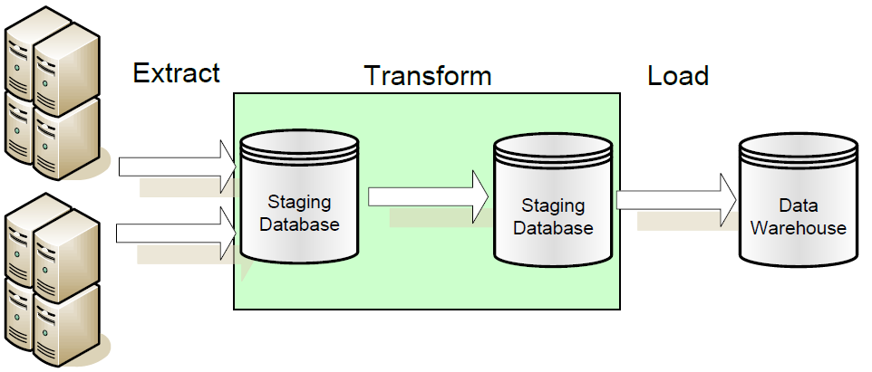
ETL – Extract Transform Load
The data transformation occurs over staged data.
The source data is not stored in the warehouse.
Data transformation processing does not occur in the data warehouse.
Notes:
To the left are your external world applications.

Slide 53
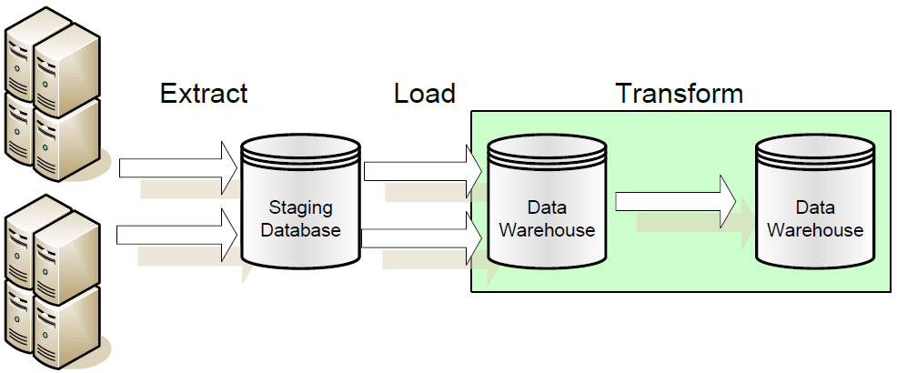
ELT – Extract Load Transform
The data transformation occurs over warehoused data.
The staged data is stored in the warehouse.
Data transformation processing occurs in the data warehouse.
Notes:
In ETL you’re not storing pre-transformed data. In ELT you are. The approach you’ll use depends on the cost of transforming the data and the usefulness of the source extract in application of the data warehouse.
For example if you’d want to implement “drill through” to a specific order it might be useful to have the official source extract as a reference.
This situation as a special component of its own, which is the subject of our next slide….

Slide 54
ODS and EDW
The CIF is a
reference architecture

Slide 55
ODS and EDW
Same definition of ODS as before:
Current, consolidated data
Updated to be current. Does not grow over time.
Inmon's EDW is a DNS:
His notion of Data Warehouse is just NDS.
Most people think of the entire CIF as a Data Warehouse.
Notes:
More on this in a bit but first.

Slide 56
Enterprise Data Warehouse
Subject-oriented, integrated, summarized, and time-variant data from the External World and Applications.
Stored in 3rd Normal form, to reduce redundancy, a NDS.
Receives data from I&T layer and the ODS.
Use as a source for data marts and decision support systems, which are stored as dimensional models.
Grows in size over time due to historical data.
The heart of the CIF.

Slide 57
ODS vs. EDW (NDS)
Characteristic | ODS | EDW/NDS
Primary Purpose | Run the business on a current basis | Support managerial decision making
Design Goal | Performance throughput, availability of information | Single version of the truth
Subject-Oriented | Yes | Yes
Integrated | Yes | Yes
Detailed Data | Yes | Yes
Data Changes | Yes | No
Time of Data | Current data | Historical snapshots
Updates | Frequent small updates | Periodic batch updates
Queries | Simple queries on a few rows | Complex queries on several rows

Slide 58

ODS and EDW/NDS Cannot share the same System
I need fast updates!
I need query performance!
You can’t have both in a Relational DBMS! Why?
Notes:
At the heart of the ODS and EDW debate is that they serve different needs. Talk to any database administrator and they’ll tell you one cannot tune the same database to support both fast queries and fast updates. It’s one or the other.
This is the rational behind the ODS. We put the data which requires updates and changes in our ODS system, and the typically static bulk-loaded read-only DW data in the EDW.
That way both systems can be configured to perform their intended function to the best of their capability.

Slide 59
Data Marts
The CIF is a
reference architecture

Slide 60
Data Marts
A collection of data tailored to the informational needs of a department or business process.
Stored in dimensional models, with fact and dimension tables.
Easy to control, low cost, and customizable due to their limited scope.
Receive their data source from the "single version of the truth" EDW.
Are source data for Online Analytical Processing (ROLAP/MOLAP) engines.
Like the DDS but does not necessarily have to be well integrated into a single data store.

Slide 61
OLAP: Online Analytical Processing
ROLAP
MOLAP
Uses a Relational Database Management System
Data design is the Star Schema
Built on well-known relational concepts
Uses a Multi-Dimensional Database Management System
Data design is the Cube
Highly flexible, includes Metadata.
Typical Kimball implementations have a ROLAP star schema feed the MOLAP cube

Slide 62
DSS Applications
The CIF is a
reference architecture

Slide 63
Decision-Support Systems
Assist with the decision making process.
Do we extend credit to a customer?
Do we restock a product?
Which roads will likely required pot-holes to be filled this year?
Get their source data from the "single version of the truth" EDW.

Slide 64
Cross-Media Storage
The CIF is a
reference architecture

Slide 65
Cross-Media Storage Manager
Stores historical data which is infrequently accessed.
Data are moved out of the EDW, which has high-end, performant storage into more affordable storage with less performant access times.
A process exists to enable some transparency in the retrieval process.
Data movement can coincide with regulatory actions.

Slide 66
Activity: Evaluating CIF Components
Activity: Research the following products. Match each to the CIF components it was designed to support. Justify your reasoning with sources. Groups will be called upon to present their findings.
Name of Product
CIF Components
Informatica ILM
PostgreSQL
Pentaho Data Integration
Birst
Tableau Server
Oracle Essbase
Microsoft Dynamics GP
IBM Informix
Corporate / External World Application
ETL System
Data Mart / MOLAP
Decision Support System
Enterprise Data Warehouse
Operational Data Store
Cross-Media Storage
Notes:
At minimum research the Product with the same group letter as you first. As time permits, do the remaining products.

Slide 68
Section: System Architectures

Slide 69
System Architectures
SMP Symmetric Multi-Processing
MPP Massively Parallel Processing
Hadoop Map-Reduce/HDFS
SCALABILITY

Slide 70
SMP
Single system with multiple CPU's
Shared Bus, Memory and I/O
CPUs Share resources on a single system.
Scales Up but not Out.
Vendors: Microsoft, Oracle, IBM, Prostgres
CPU
CPU
CPU
CPU
Bus
Memory (RAM)
Disk I/O

Slide 71
MPP
High-Speed Interconnect
Multiple SMP nodes interconnected to form a single cluster.
Data are partitioned across nodes in the cluster.
Single control node to orchestrate queries and data management.
Processing and data partitions are tied together.
Specialized Hardware. Difficult to scale out once configured.
Vendors: Teradata, IBM Netezza, Vertica, Oracle, Microsoft
SMP
Node1
SMP Node2
SMP Node 3
SMP Node 4
Part 1
Part 2
Part 3
Part 4

Slide 72
Map-Reduce
Name
Node1
Name
Node1
Name
Node1
Name
Node1
General purpose distributed batch processing framework.
Fault Tolerant.
Runs on affordable commodity hardware.
Processing and Data are decoupled and distributed over the network
Slower Query execution than MPP.
Vendors: IBM, Cloudera, Hortonworks, MapR
Network
Data
Node 1
Data
Node 2
Data
Node 3
Data
Node 4

Slide 73
Comparisions
Factor | SMP | MPP | MapReduce
Workloads | Small | Large | Very Large
Scale | Up | Up and Out | Up and Out
Technology Cost | Low | Very High | Low to High
Implementation Cost | Low | Moderate | High
Distributed | No | Processing and Data together | Processing and Data Independently.
SQL Compliant | Yes | Yes | Somewhat
Fault-Tolerance | No | No | Yes
Nodes | 1 | 100's | 1000's
Hardware | Appliances and Commodity | Mostly Appliances | Commodity

Slide 74
Check Yourself
The consensus on distributed (scale out) systems is that they should be avoided unless required. Why is this the case?
Spend 10 minutes researching this online and see what you come up with.
Notes:
Scaling out is costly in hardware, software and the overhead required to manage it.
Oftentimes there's a tendency of organizations and IT zealots to jump on the scale-out bandwagon, but in reality you don't want to do it unless you absolutely have to.
Here's a nice article about hadoop overuse. Enjoy and feel free to sound off in the live session.
https://www.chrisstucchio.com/blog/2013/hadoop_hatred.html

